Slide 1
Empolyee datasets analysis using excel
STUDENT NAME: SAKTHI SADHANA.S
REGISTER NO: 422200513
NAAN MUDHALVAN ID:CC5A32D72E31CC09D064D7208D5FA4D4
DEPARTMENT: B.COM(ISM)
COLLEGE NAME: VALLIAMMAL COLLEGE FOR WOMEN

Slide 2
PROJECT TITLE
EMPOLYEE SALARY ANALYSIS USING EXCEL

Slide 3
aGENDA
PROBLEM STATEMENT
PROJECT OVERVIEW
END USERS
OUR SOLUTION AND PROPOSITION
DATASET DESCRIPTION
MODELLING APPROACH
RESULTS AND DISCUSSION
CONCLUSION

Slide 4
PROBLEM STATEMENT
THIS SALARY ANALYSIS IS USED TO FIND OUT WHETHER THE SALARY OF THE EMPLOYEE IS INCREASED OR NOT.

Slide 5
PROJECT OVERVIEW
ANALYSE THE SALARY OF THE EMPLOYEE BY CONSIDERING VARIOUS FACTORS OF LIKE GENDER,EMPLOYEE ID,START DATE, EMPLOYEE TYPE,DEPARTMENT,ETC., WE USE THIS IN ORDER TO IDENTIFY THE TRENDS,PATTERNS OF DIFFERENT CATEGORIES OF EMPLOYEE SALARY LIKE VERY HIGH,HIGH,MEDIUM, AND LOW,.

Slide 6
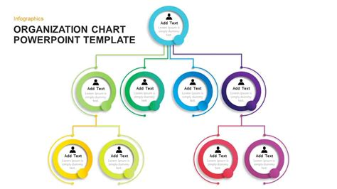
WHO ARE END USERS

Slide 7
OUR SOLUTION AND IT’S VALUE PROPOSITION
Conditional Formatting – Blank values.
Sort & Filter – Filter – Remove Blank Values.
Formula – Salary .
Pivot Table – Summary.
Graph – Data Visualization

Slide 8
DATASET DESCRIPTION
Employee Dataset – Edunet Dashboard.
11 Features .
5 Features.
Employee ID – Numerical Values.
Name – Text.
Gender – Text.
Salary – Numerical Values.
Start Date – Numerical Values

Slide 9
THE “ WOW “ IN OUR SOLUTION
We use this formula
=IFS(Z8>=5,”VERYHIGH”,Z8>=4,”HIGH”,Z8>=3,”MED”,TRU
E,”LOW”)
To find the salary level of the employee

Slide 10
MODELLING
DATA COLLECTION :
Naan mudhalvan
Edunet dashboard
FEATURE SELECTION :
11 Features.
5 Features.
DATA CLEANING :
Colour blank values
Filter – Remove Blank Values

Slide 11
SALARY LEVEL :
▪ Very High.
▪ High.
▪ Medium.
▪ Low.
PIVOT TABLE :
▪ Employee ID.
▪ Name.
▪ Gender.
▪ Salary.
▪ Salary level
▪ Start date.
▪ Employee Type

Slide 12
CHART :
▪ Employee ID.
▪ Name.
▪ Gender.
▪ Salary.
▪ Salary Level.
▪ Start Date.
▪ Employee Type.
▪ Data Visualization.

Slide 13
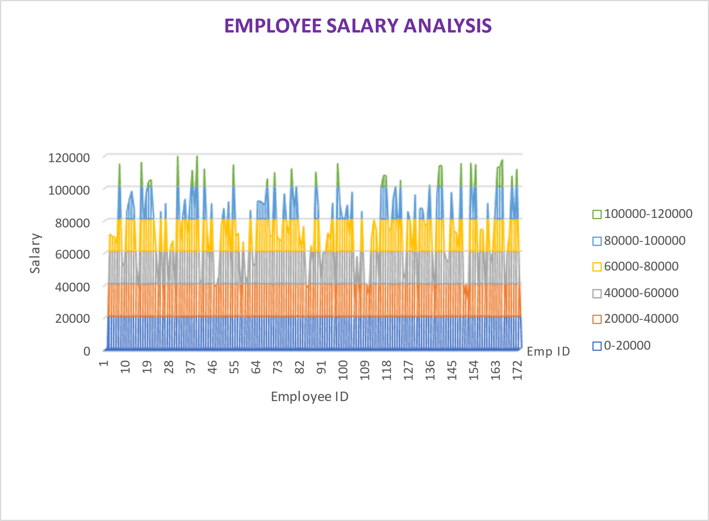
Result

Slide 14
Conclusion
While comparing the salary level of the employee , the employee’s
are getting their salary according to their employee type and start date.

